Slide 1

Stroke Prediction
By
George Ajayi

Slide 2
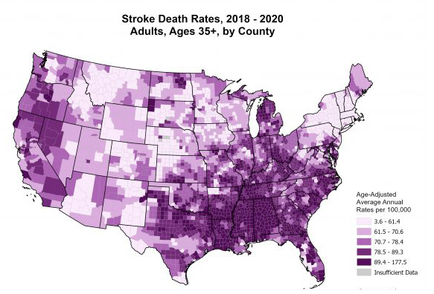
Why the Prediction ?
In Every 40 seconds, someone in the United States has a stroke and Every 3.5 minutes, someone dies of stroke. Every year, more than 795,000 people in the United States have a stroke and about 610,000 of these are first or new strokes.
Using the stroke prediction data we’ll be able to predict if a person will suffer from stroke in the near future, so they can take necessary steps and make some adjustments in their way of living in order to avoid suffering from the disease.

Slide 3
Dataset for the Stroke Prediction
id
Gender
Age
Hypertension
Heart disease
Ever Married
Work Type
Residence Type
Average Glucose Level
BMI
Smoking Status
Stroke
Listed on the left are the features in our stroke prediction dataset with the Stroke feature being our target. It’s a classification problem which has only 2 categories ‘No Stroke’ OR ‘Stroke’.
According to the Center for Disease Control and Prevention the major features in this dataset are also the contributing factors to Stroke in the United States.
These features include Hypertension, Pre existing Heart Diseases, Marriage; If someone is consistently under pressure or being stressed at a work place is a contributing factor. Average Glucose Level, Body Mass Index (BMI) and Smoking Status are manageable factors that can also lead to stroke depending on lifestyle choices.

Slide 4
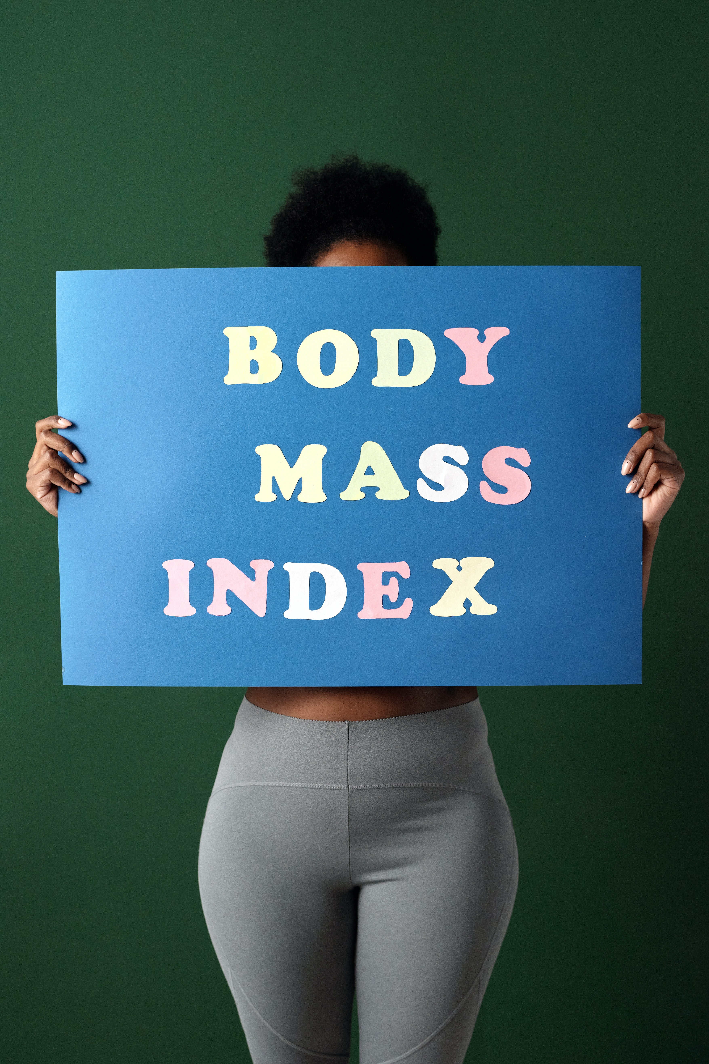
Body Mass Index
(BMI)
Body Mass Index (BMI) is a person’s weight in kilograms (or pounds) divided by the square of height in meters (or feet). A high BMI can indicate high body fatness; BMI screens for weight categories that may lead to health problems.

Slide 5
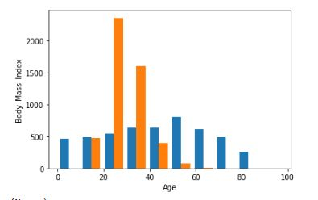
Body Mass Index (BMI)
In Explanatory Visualization
In the Histogram on the right, it shows patient at age 24 and under, and those above the age of 75 have a lower Body Mass Index. Teenagers and young adult are a lot mobile and tend to engage in more outdoor activities than any other age groups which contributes to a lower Body Mass Index. Those in of age range of 75 and up tend to shrink down in size the older they get which also contributes to a lower Body Mass Index. The histogram shows other age groups with a higher Body Mass Index. Obesity and Excess weight does increase the risk of severe illness and other health problems.

Slide 6

Marriage
The Institution of Marriage is a manageable factor because it has it’s cons and pros. However, it can come with lots of stress based on some important factors surrounding a marital relation.
First and fore most one’s choice of life partner is a very big factor, then you have other manageable factors such as Emotional Stability, Financial Security, Work-Life Balance, Parenting and third Party interference. Pre-marital and marital counselling are highly recommended for married couples.
Unfortunately today in the United States, couple often self-medicate while dealing with stress, some self medicate on pain killers while others lean towards smoking which leads to health issues.

Slide 7
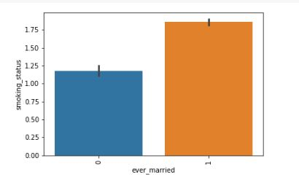
Marriage
In Explanatory Visualization
In the Bar-plot on the right, we see that marital status correlates with smoking status. We also see that married patients have a higher smoking rate than unmarried patients. Marriage can cause lots of stress that turns a none-smoker into a smoker.

Slide 8

Summary of Model
Our model was created to help predict the Outcome of Stroke Disease using the features in our dataset, though it required cleaning and transformation. It was also feature engineered by applying PCA to speed up the run time.
The 2 classification models were created to predict the outcome of Stroke Disease, the first model is a DecisionTreeClassifier and the 2nd model is KNeighborsClassifier. Evaluating both models using GridSearch CV and Classification Report, we end up with an identical test score for both first and second model.
The 2nd model out of the 2 models was selected for production because it has just the concise number of hyper parameters needed for tuning which also makes it an ideal model to use in predicting of Stroke.

Slide 9
References
Data Source:
Center for Disease Control and Prevention
https://www.cdc.gov/stroke/facts.htm
https://www.cdc.gov/healthyweight/assessing/bmi/
Image Sources:
Rheumatology Advisor
https://www.rheumatologyadvisor.com/home/topics/rheumatoid-arthritis/can-artificial-intelligence-predict-patient-outcomes-in-rheumatoid-arthritis/
Pexels
https://www.pexels.com/

